Slide 1



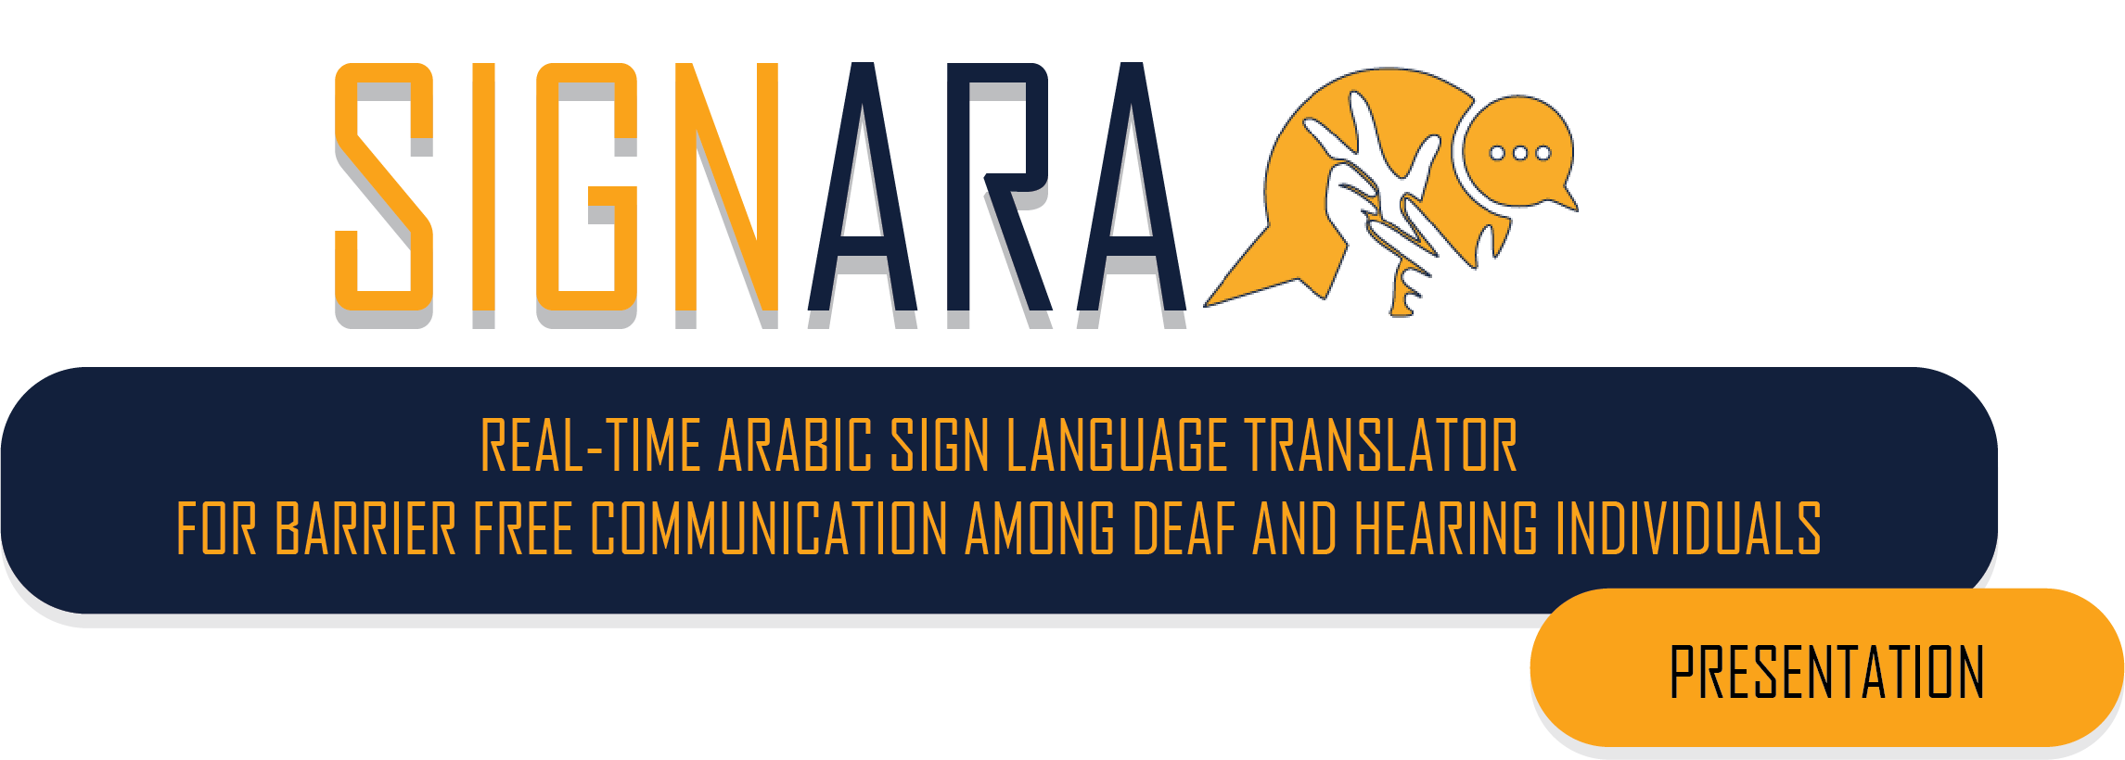

Slide 2


MEET THE TEAM
PETER BOSHRA AZIZ
AYA TAREK ELGHANNAM

Slide 3
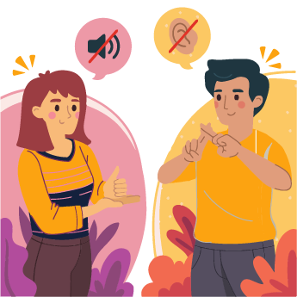
INTRODUCTION
Sign language is a form of manual communication and is one of the most natural ways of communication for most people in deaf community.
The aim of the sign language recognition is to provide an accurate and convenient mechanism to transcribe sign gestures into meaningful text or speech so that communication between deaf and hearing society can easily be made.
In order for an ordinary person to communicate with deaf people, an interpreter is usually needed to translate sign language into natural language and vice versa.
Notes:
Human-Computer Interaction (HCI) is getting increasingly important as a result of the increasing significance of computer's influence on our lives. Researchers are trying to make HCI faster, easier, and more natural. To achieve this, Human-to-Human Interaction techniques are being introduced into the field of Human-Computer Interaction. One of the richest Human-to-Human Interaction fields is the use of hand gestures in order to express ideas

Slide 4

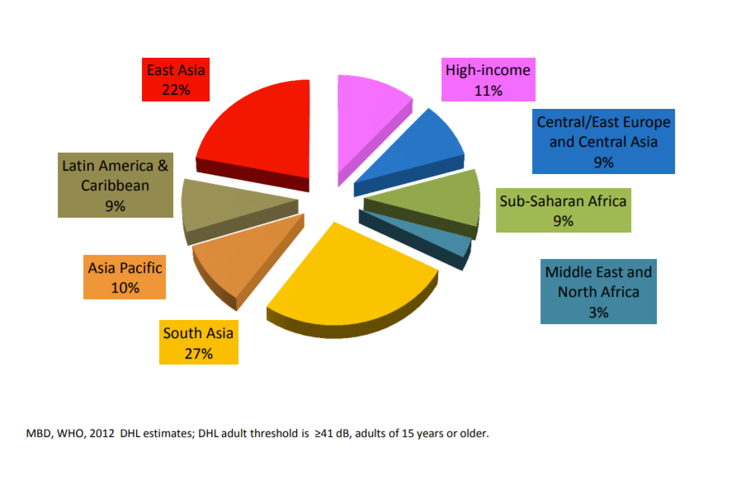
PROBLEM STATEMENT
Deafness and hearing loss are widespread and found in every region and country. An estimated 466 million people worldwide – 5.5% of the population – have disabling hearing loss, and this number is expected to rise to 1 in 4 by 2050.
WHO estimates that unaddressed hearing loss costs the global economy US 980 billion dollars annually due to health sector costs.
Low- and middle-income countries bear a disproportionate burden from hearing loss. WHO estimates that global hearing aid production covers just 3% of the need in these countries

Slide 5
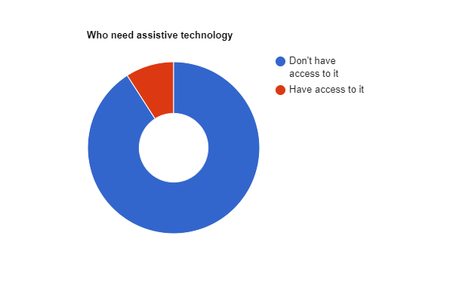
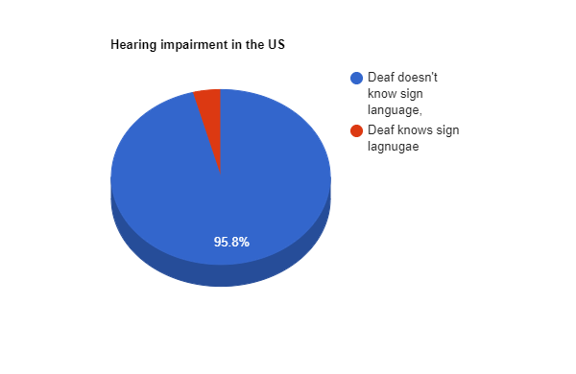
The Seventy-first World Health Assembly : 26 May 2018
considered the report on improving access to assistive technology Considering that one billion people need assistive technology.
Recalling that 90% of those who need assistive technology do not have access to it and that this has a significant adverse impact on the education, livelihood, health, and well-being of individuals, and on families, communities, and societies.
Another problem that faces the hearing impairment community is lack of sign language knowledge even among hearing-impaired themselves, example in the US even though there are 48,000,000 deaf individuals only 2,000,000 are Sign language Speakers.

Slide 6
DIFFICULTIES THE HEARING INDIVIDUALS FACE EVERYDAY
Sign language misunderstandings
Sign language is far from universal, and different standards exist in different countries of the same language Ex: the differences between Egyptian and Libyan Sign Language
Job applications and interviews
Those who are hard of hearing or deaf may sometimes feel completely ignored when they reveal their hearing status on application forms, possibly because recruiters see it as too much extra work to accommodate them.
Depression and anxiety
Studies reveal that deaf people are around twice as likely to suffer from psychological problems such as depression and anxiety. Research suggests this stems from feelings of isolation.
Social Isolation
Nine in 10 deaf children are born to hearing parents, yet less than a third have family members who sign regularly.

Slide 7

PROPOSED SOLUTION
We used the power of assistive technology to increase the quality of life by opening up new opportunities to disabled people and increasing the range of options open to them.
Our team developed an artificial intelligence (AI) powered system for the deaf and mute people, Implementing our solution on mobile and web applications will offer a low-cost superior approach to translating Arabic sign language into text and vice versa in real-time.
The proposed Arabic Sign Language Translator system does not rely on using any gloves or visual markings to accomplish the recognition job. As an alternative, it deals with images of bare hands, which allows the user to interact with the system in a natural way.

Slide 8
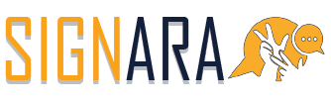
INTRODUCING
Easy-to-use innovative digital interpreter dubbed as “Google Translate for the deaf and mute” works by placing a smartphone or webcam in front of the user while the app translates gestures or sign language into text.
SIGNARA uses neural networks and computer vision to recognize the video of a sign language speaker and then smart algorithms translate it into speech. And the vise versa works by animating the input text into sign language.

Slide 9

DEMO VIDEO

Slide 10

DEMO VIDEO

Slide 11
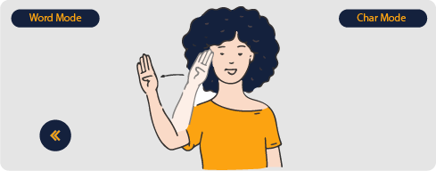
SIGN TO TEXT
The goal of SIGNARA is to develop software that is capable of real-time translation of Arabic sign language into text. Due to resources and time constraints, the scope has been limited to completing 9 Words and the whole Arabic alphabet.
Our system has 2 main sectors:
- Words - Characters

Slide 12
WORDS
Challenges we faced while doing this part for having a dynamic data that can be represented as series of motion .
How long does a word sign take ? is there deviation ?
We agreed to implement the basic language words on SIGNARA which we found that it takes about 1 second, with a large deviation So we implemented our code to collect a 30/60 fps for the dataset. to capture the variations during the movement.
How to deal with FPS variance ?
We dealt with our approach using Virtual button which requires a static number of inputs 30 frames , with countdown time to avoid overlapping and increase performance
When to use words neural network and when to use alphabet model ?
Our system has two neural network (one for static alphabet will be discussed later and one for dynamic words), So we decided to make a virtual button in our screen that will change the mode to either word mode or character mode by clicking with both index and middle fingers combined

Slide 13
DATASET
Step one: Data Collection
After doing online research we found that there is no public dataset for the Arabic Sign Language words which contain continuous motion. So, we started collecting our dataset by capturing video that takes 30 and 60 Frames of the word motion. We Captured 120 videos of 2 different data collectors to have a variety.
Step Two: Transforming Images to Key-points
MediaPipe Hand is a high-fidelity hand and finger tracking solution. It employs machine learning (ML) to infer 21 3D landmarks of a hand from just a single frame. Whereas current state-of-the-art approaches rely primarily on powerful desktop environments for inference, Mediapipe method achieves real-time performance on a mobile phone, and even scales to multiple hands.

Slide 14

Step Three: Landmarks Augmentation Data augmentation we used 2 types of augmentation that are normally variable with respect to the user during system usage the scale (how close is the user to the camera) and the orientation (what angle is the camera held).
We used 2 augmentation 1- by adding a random scale factor from 0 to 1. 2- by adding a random rotation factor from -5 degrees to 5 degrees. 3- by adding both 1 and 2.

Slide 15
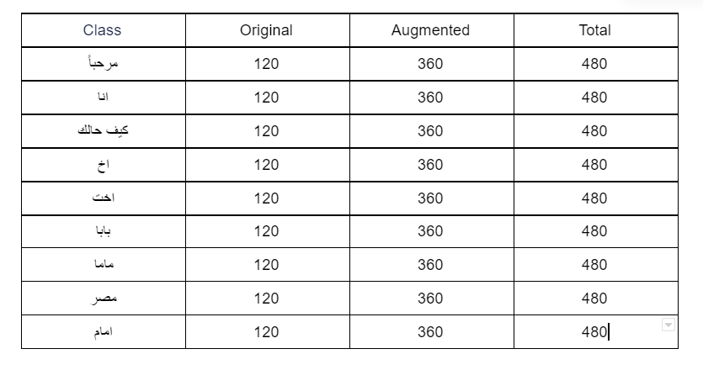
DATASET

Slide 16
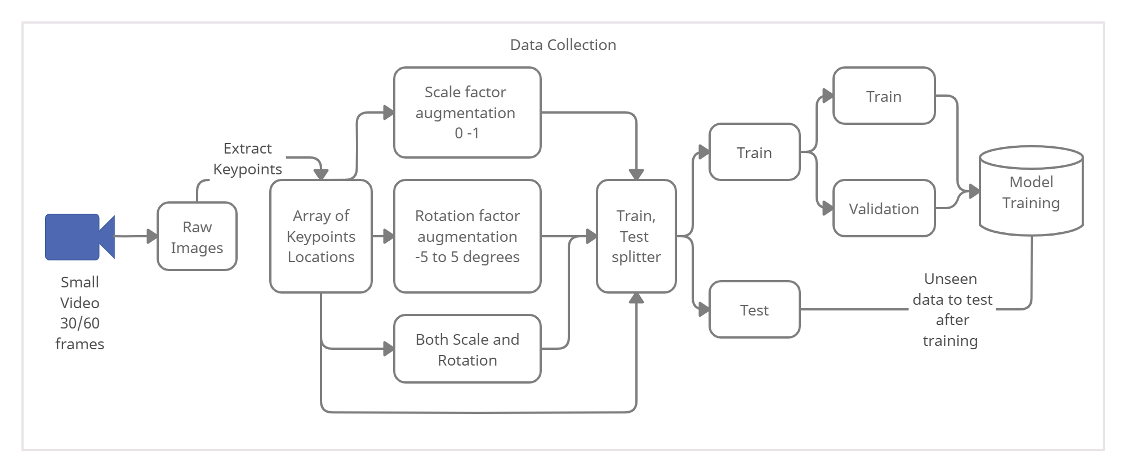
DATA COLLECTION

Slide 17
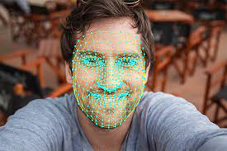

FEATURE ENGINEERING
Before the neural network it was challenging for us to decide what are the features that will mainly
affect the motion without confusing the model we tried 4 different features.
1- Pose + Hands + face Landmarks Coordinates in each frame.
2- Difference between X,Y of pose + hands landmarks between 2 consecutive frames.
3- Distance between Hand Landmarks and specific points of human pose.
4 - Hands Landmark Only X,Y Coordinates in each frame

Slide 18
DEEP LEARNING MODELS
Human activity recognition is the problem of classifying sequences of accelerometer data recorded by specialized harnesses or smart phones into known well-defined movements.
We applied our knowledge and tried many deep learning algorithms in order to get insight of the performance by comparing different approaches.
- CONV1D
- LSTM
- CONV1DLSTM
- LSTM With CTC Loss
- Transformers.

Slide 19
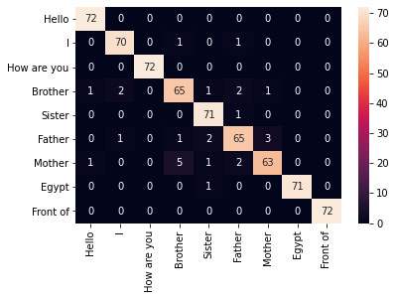
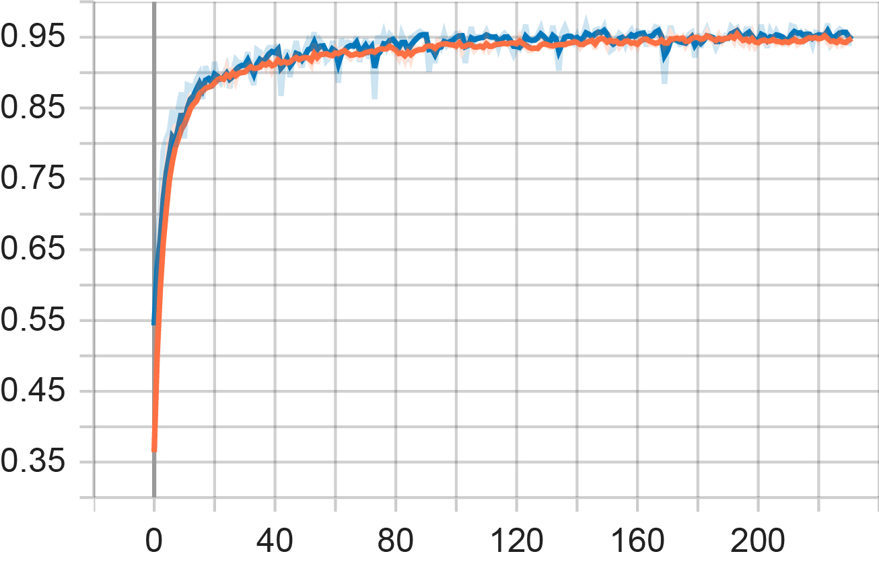
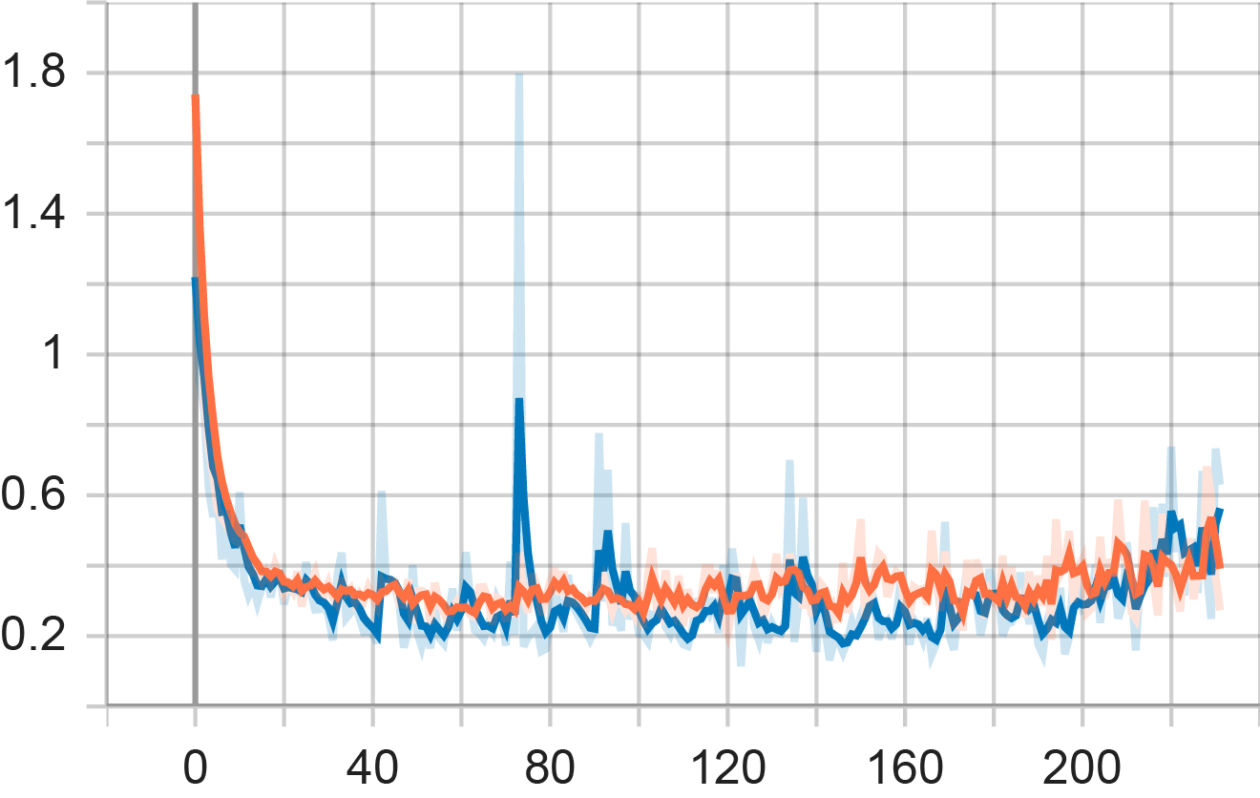
CONV1D
Results Training Accuracy = 0.9248 Validation Accuracy = 0.93981 Training Loss = 0.265 Validation Loss = 0.3305

Slide 20
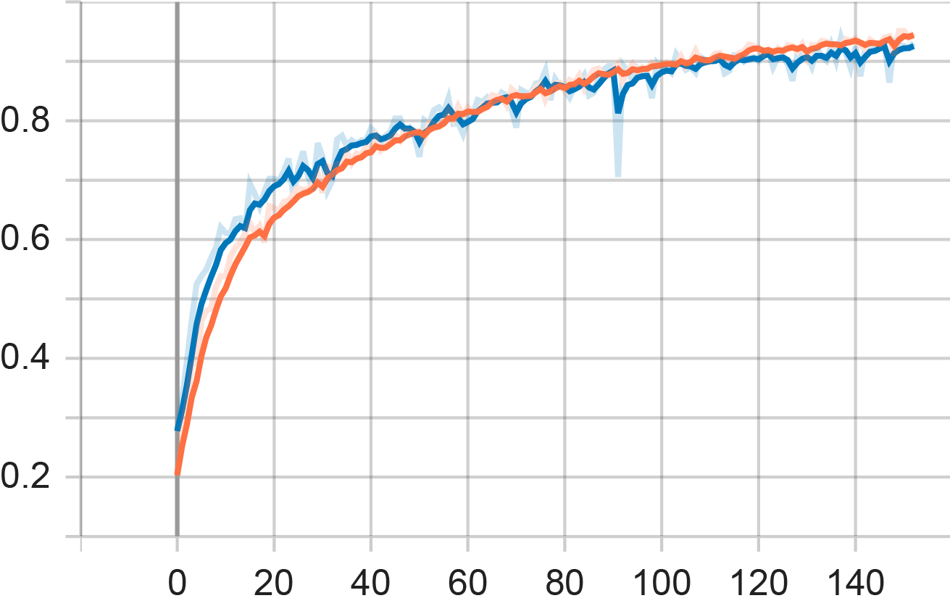
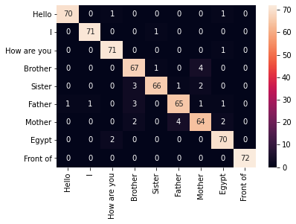
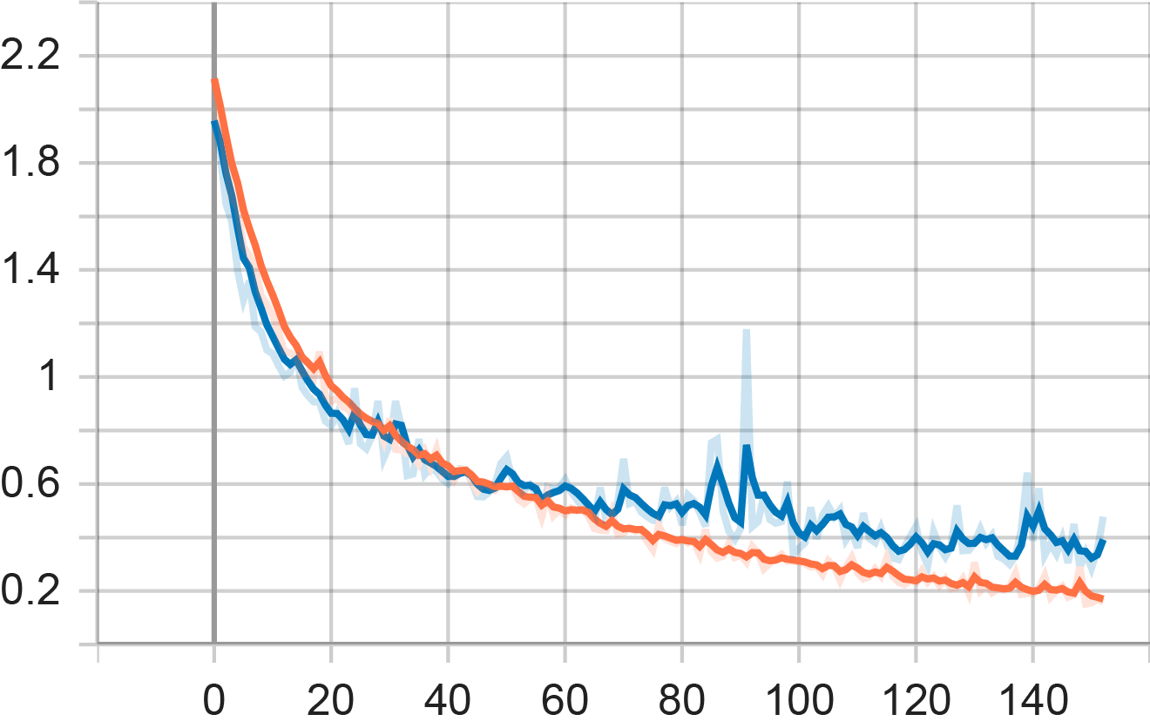
LSTM
Results Training Accuracy = 0.9892 Validation Accuracy = 0.93738 Training Loss = 0.0272 Validation Loss = 0.1387

Slide 21
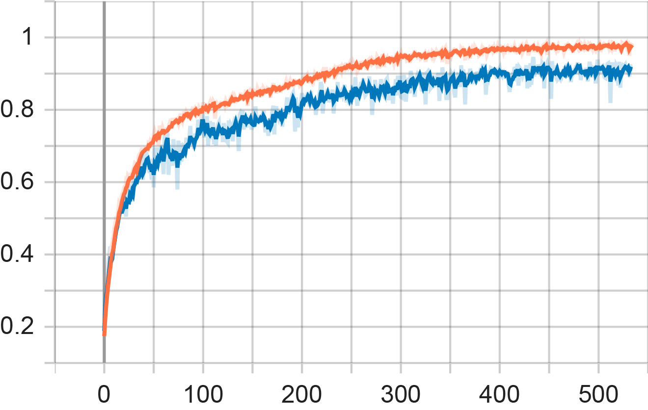
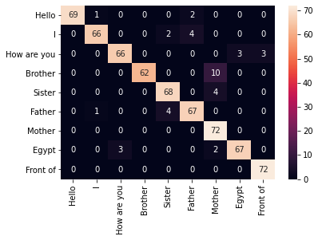
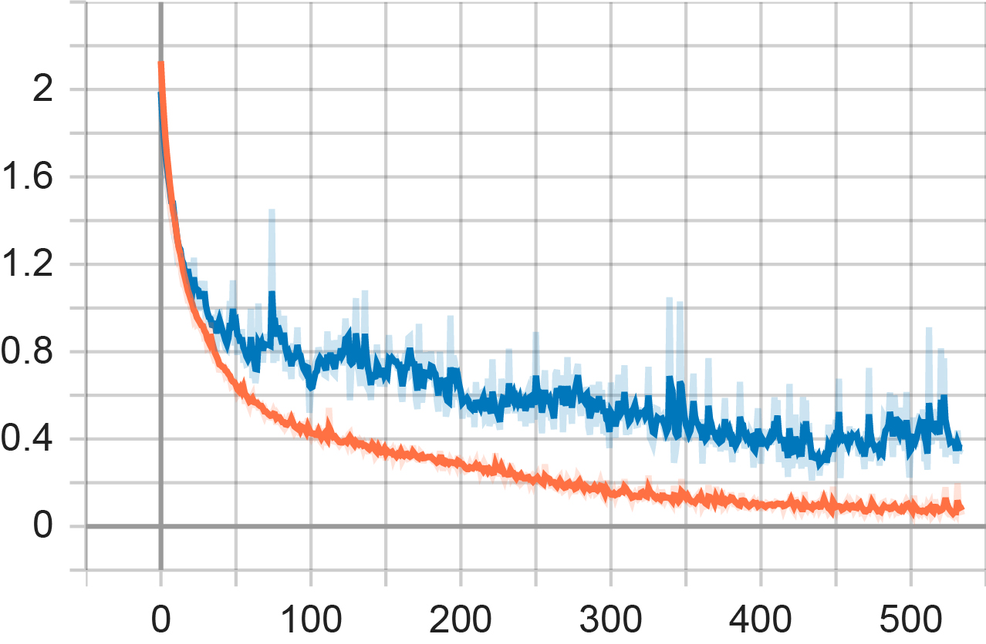
TRANSFORMERS
Results Training Accuracy = 0.9865 Validation Accuracy = 0.948
Training Loss = 0.0432 Validation Loss = 0.242

Slide 22
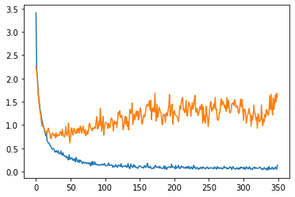
LSTM With CTC
In our case we don’t know how fast the user will do the sign! some users are slower than others. during collecting the data set we did each sign in one second but this won’t be the case during the use.
------ Training Loss ------ Validation Loss

Slide 23
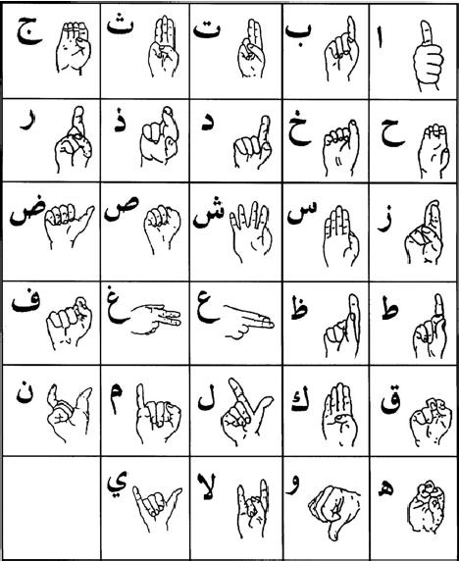
CHARACTERS
This part is simpler as the characters are static unlike words also we found some resources online which made it easier.
DATA COLLECTION
We found dataset consists of 54,049 images of ArSL alphabets performed by more than 40 people for 32 standard Arabic signs and alphabets.
We also added to it our feed by collecting extra dataset manually of 200 images for each class gathered by two persons of different hand sizes RGB but this time by using hand-tracking function that crop the hand bounding box changing the dimensions based on the sign itself.

Slide 24
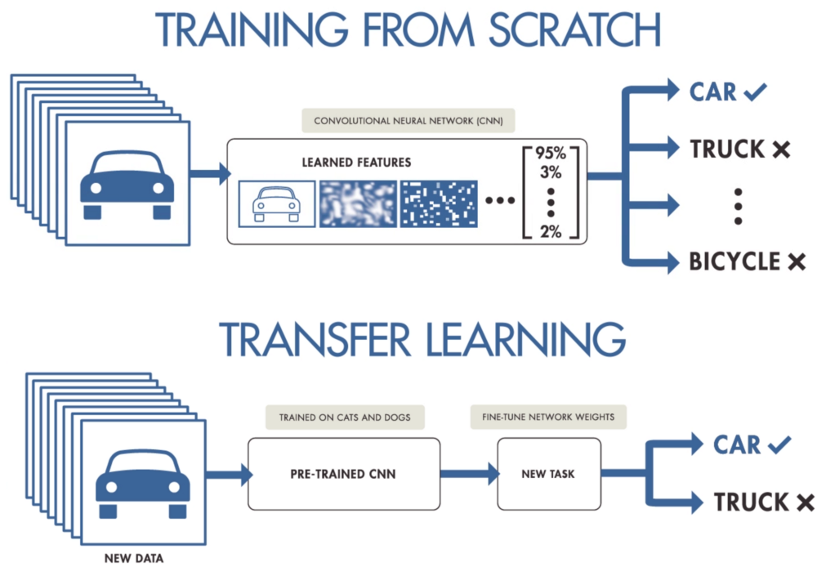
DEEP LEARNING MODEL
Transfer learning has the benefit of decreasing the training time for a neural network model and can result in lower generalization error
Models for Transfer Learning
There are perhaps a dozen or more top-performing models for image recognition that can be downloaded and used as the basis for image recognition and related computer vision tasks.
In our Approach we used VGG16 Model ,The model achieves 92.7% top-5 test accuracy in ImageNet, which is a dataset of over 14 million images belonging to 1000 classes

Slide 25
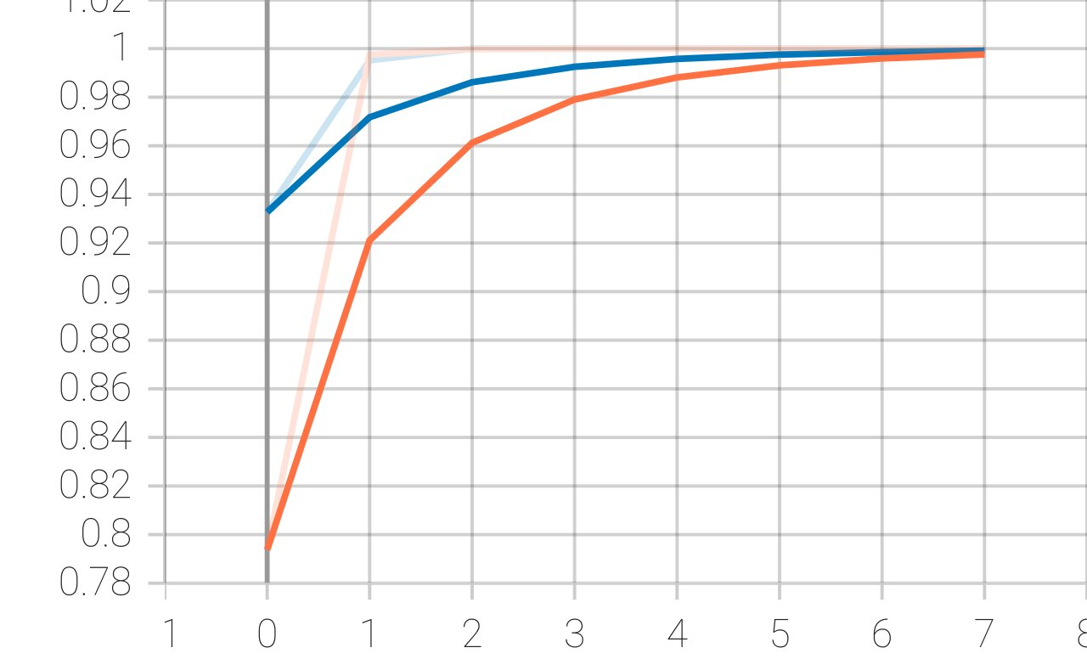
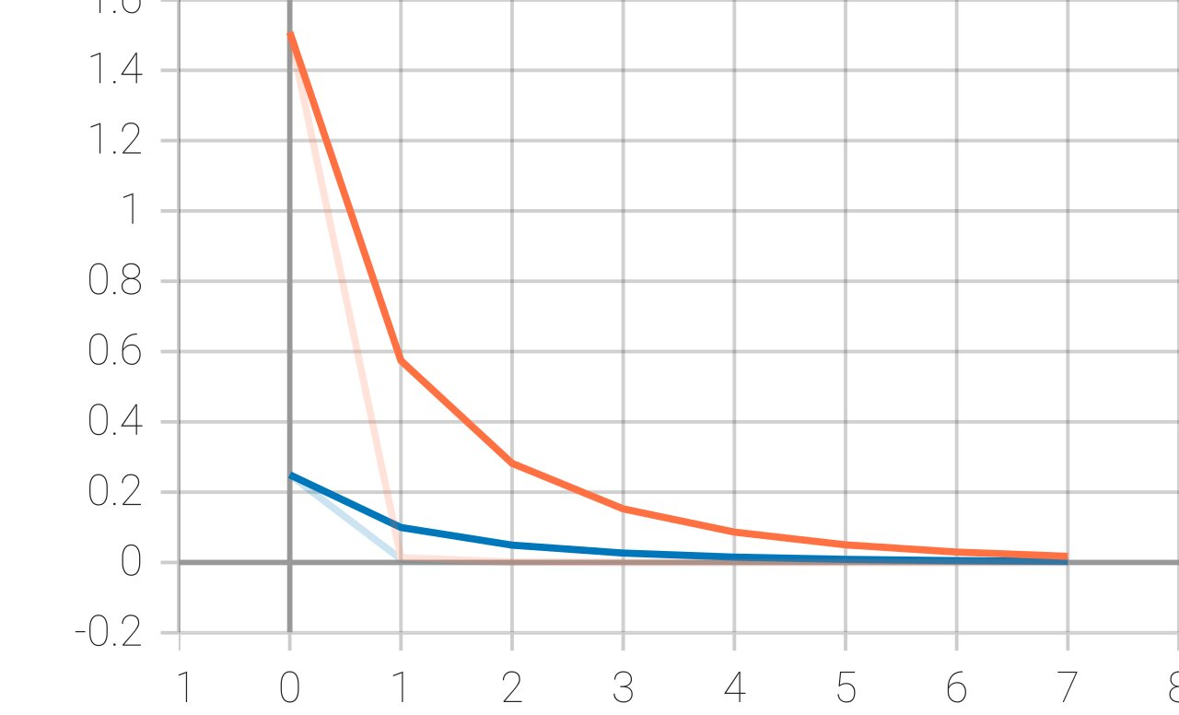
TRANSFER LEARNING (VGG16)
Results Training loss: 1.0453e-07 Training accuracy : 1.0000 Validation loss: 1.3472e-06 Validation accuracy: 1.0000

Slide 26
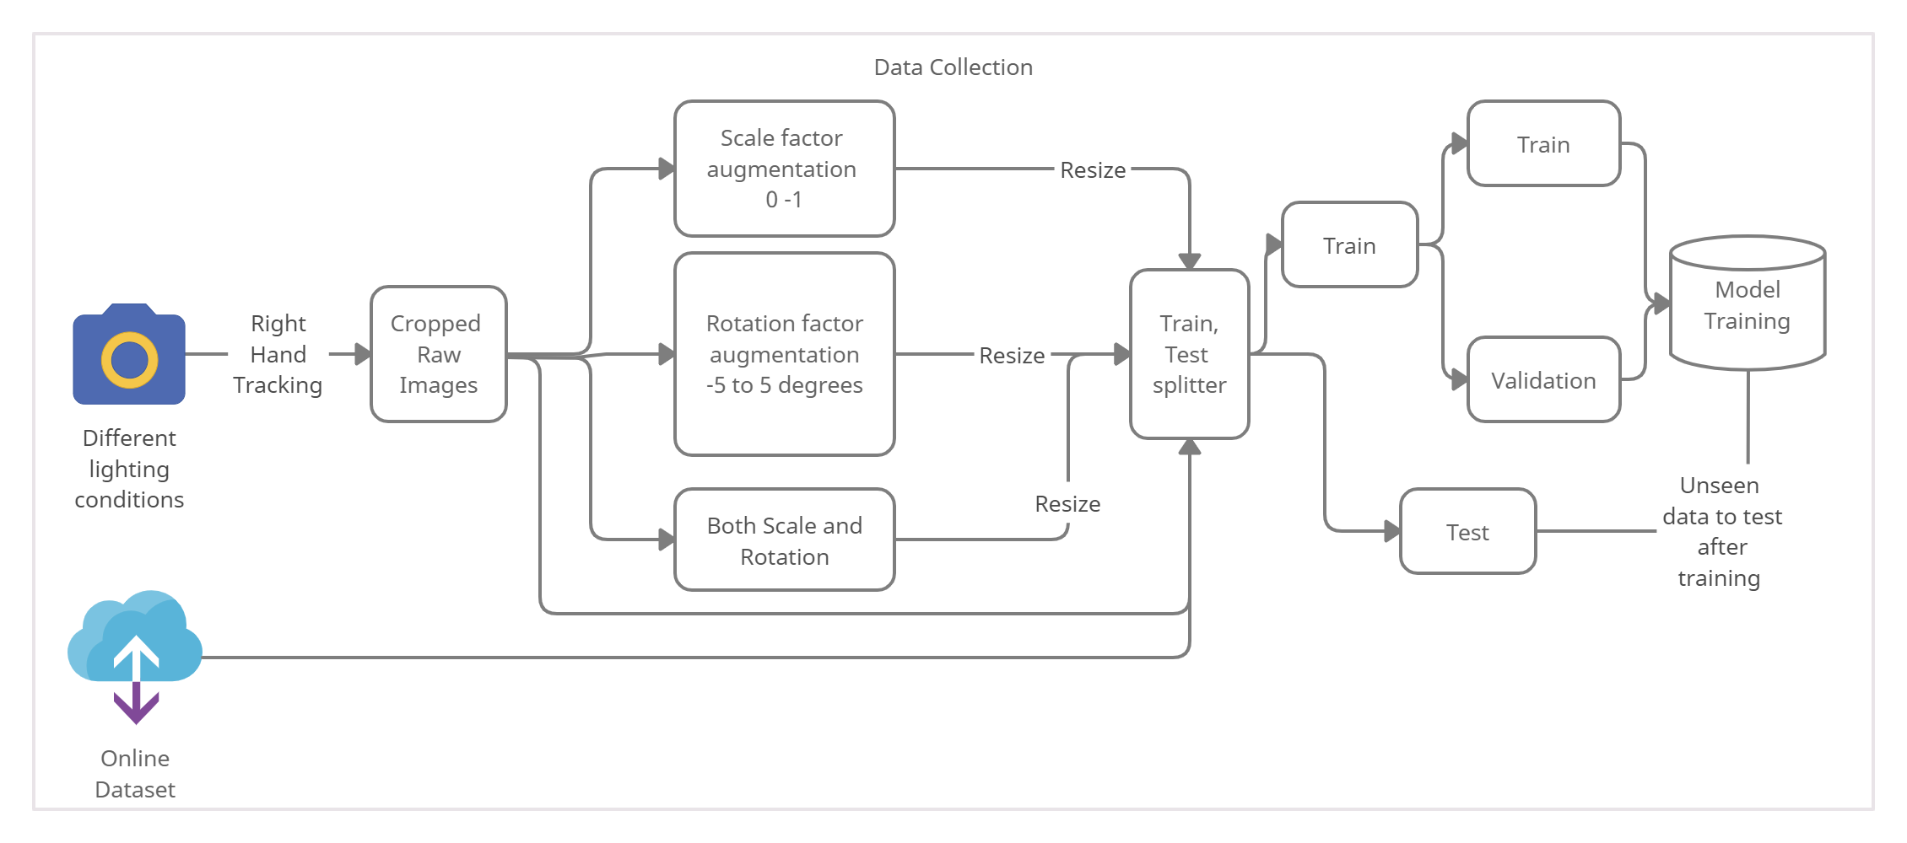
CHARACTERS SUMMARY

Slide 27
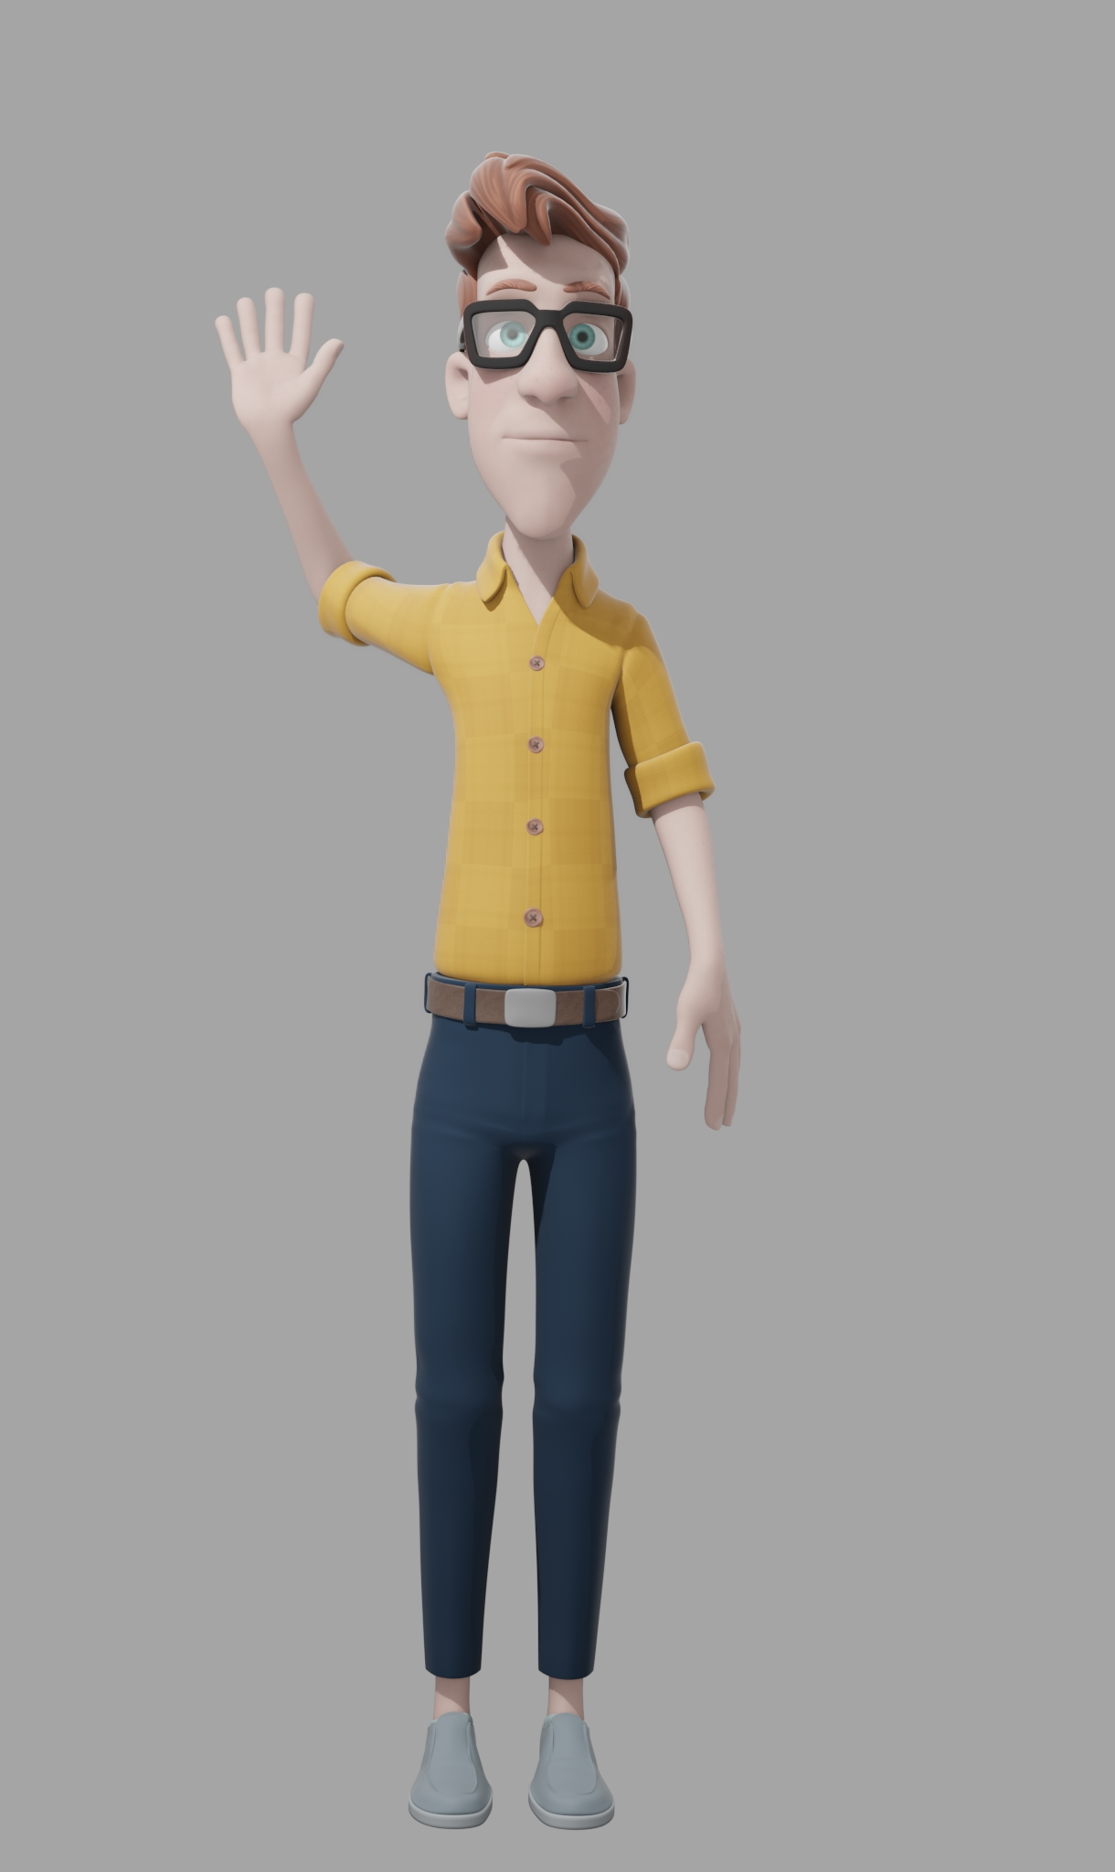
TEXT TO SIGN
A critical part of animating a sign language using virtual avatar is to display a sign gesture having multiple rotational arm poses to identify a word instead of a single static arm pose.
Sequencing a group of gestures related to a sentence requires each gesture in the middle of a sentence to be animated using different initial arm positions.

Slide 28
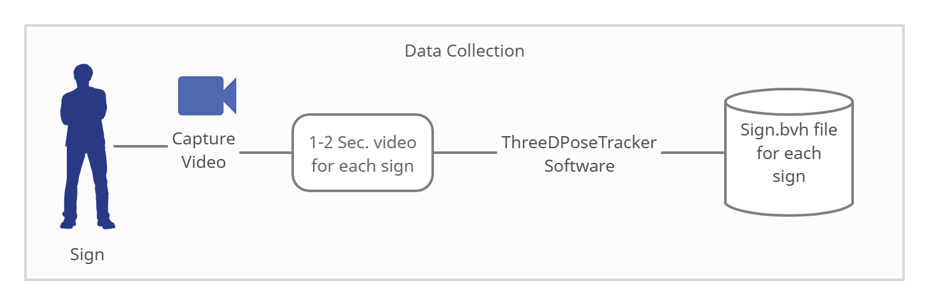
TEXT TO SIGN FLOW

Slide 29
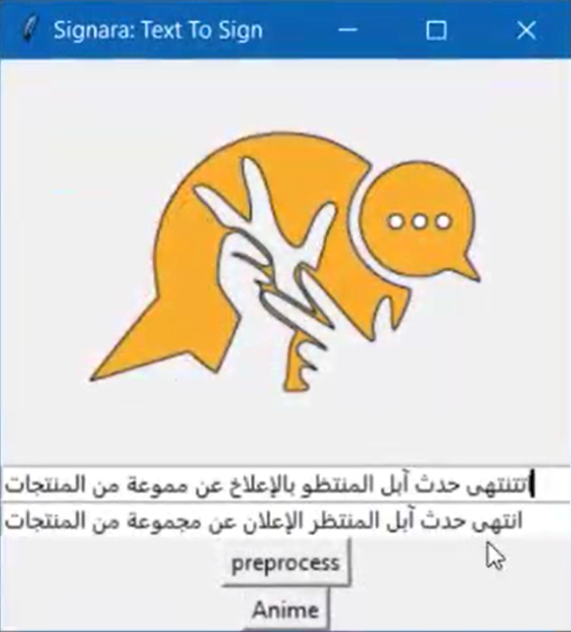
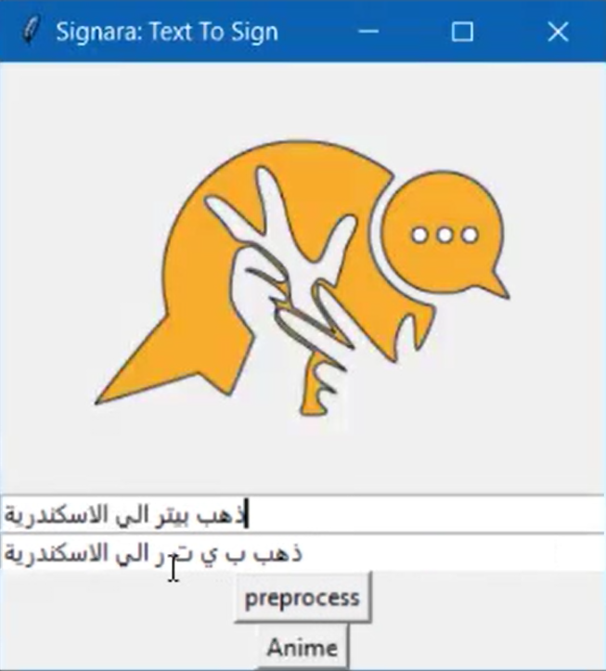
TEXT TO SIGN PROCESSING
Spell corrector NER

Slide 30
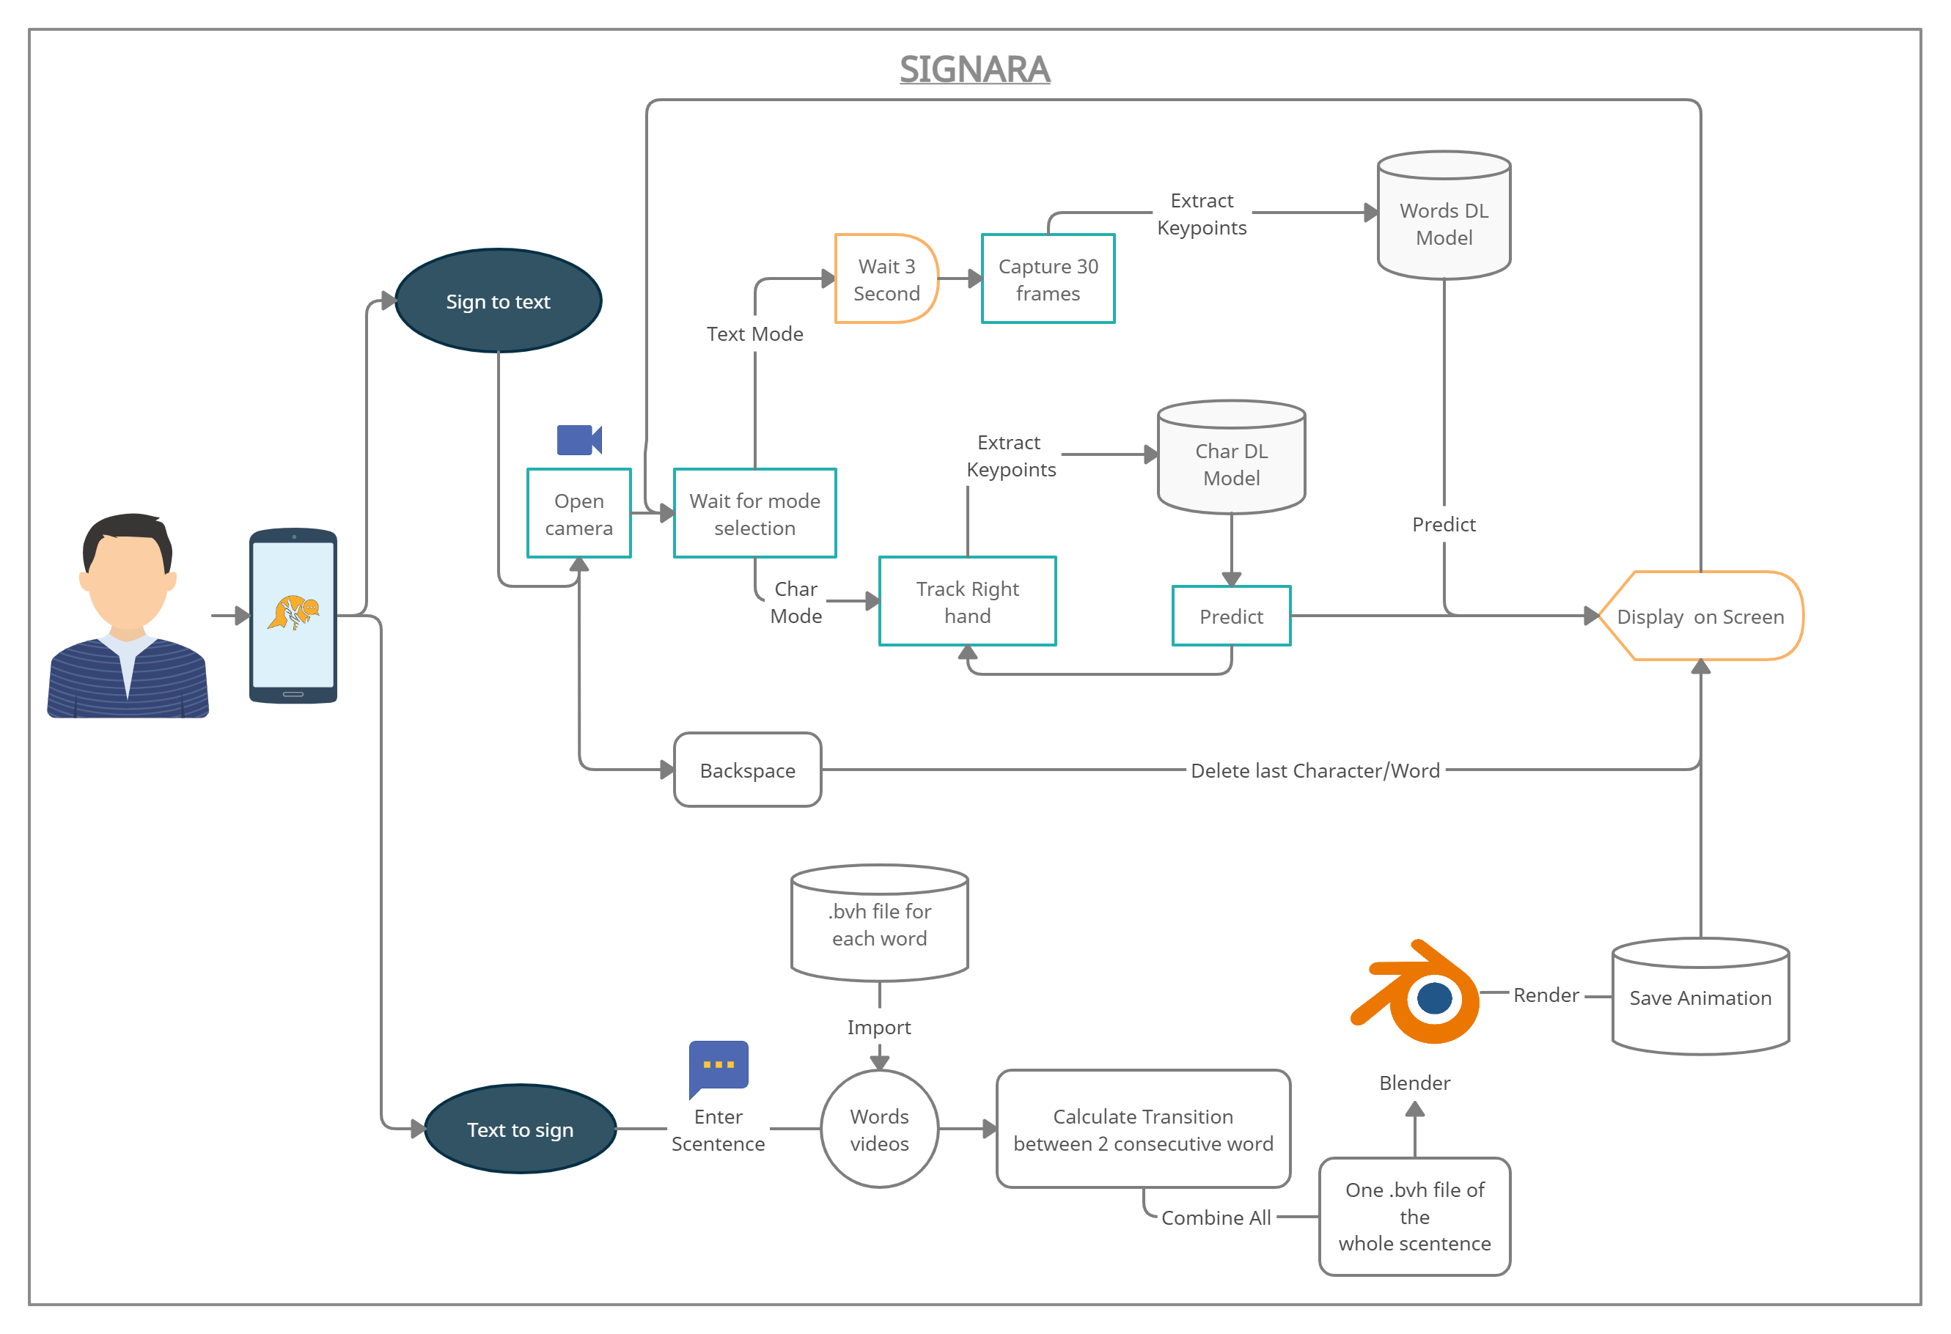
SYSTEM

Slide 31
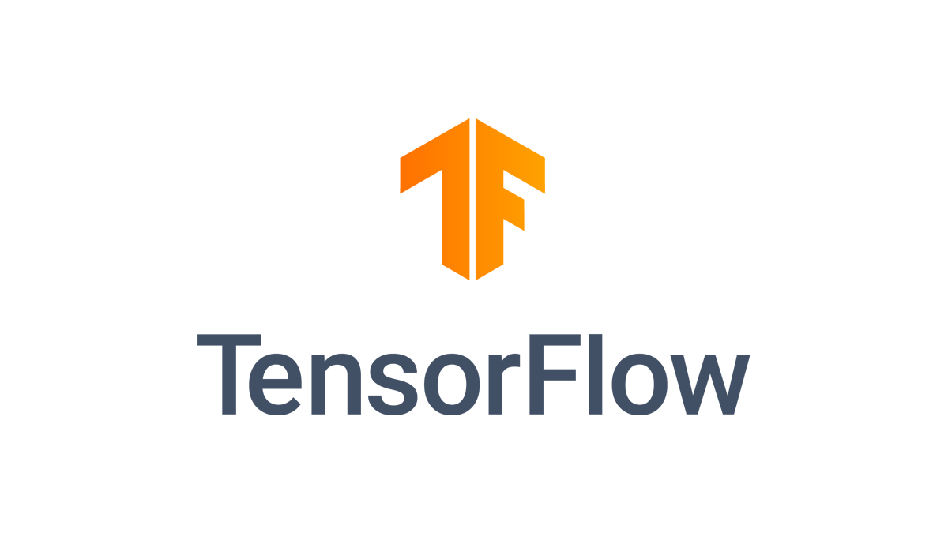



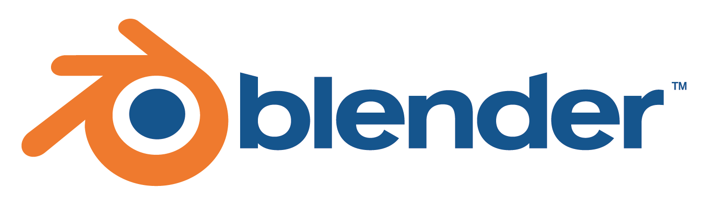

TECHNOLOGIES USED
FOR SAKE OF COLLABORATION

Slide 32
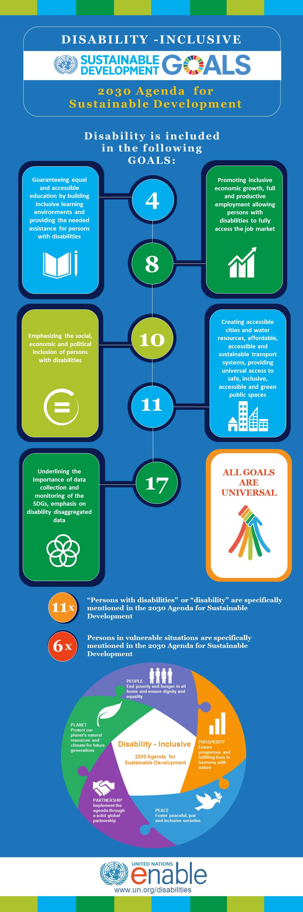
POSITIVE IMPACT ON SUSTAINABILITY
The UN 2030 GOALS for Sustainable Development emphasizes the importance of Disability-Inclusion, to maintain sustainability across the world, we have to strive to give everyone equal opportunities, and this means focusing on being Disability-Inclusive, and as engineers we strive to design solutions and devices to help facilitate the integration of Persons with disabilities into society.

Slide 33
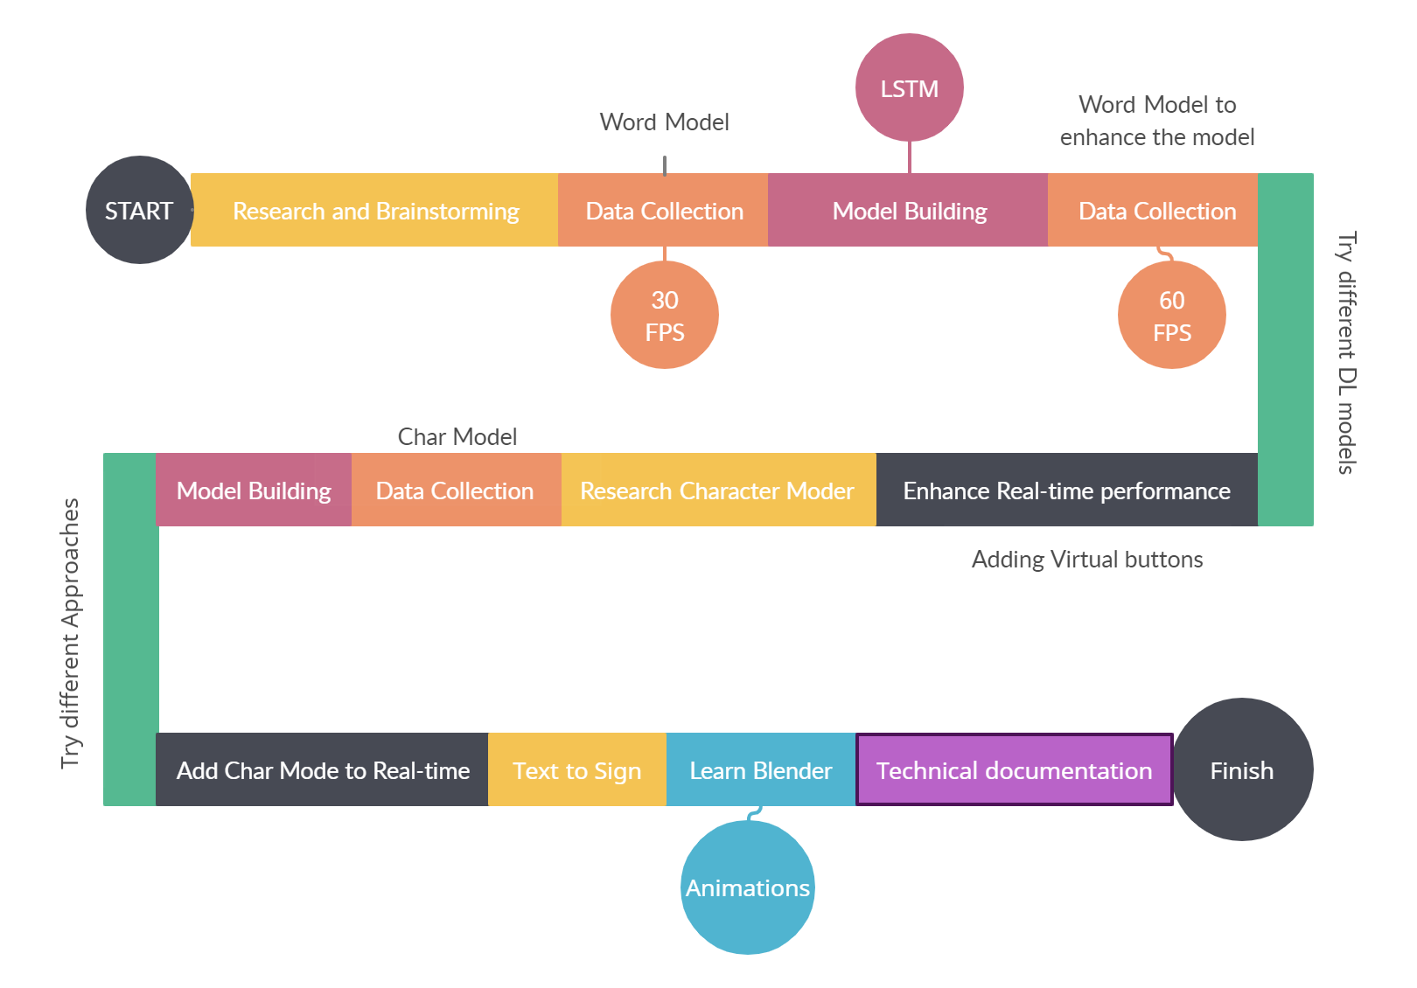
WORKFLOW
Our main focus was to apply all the experience we gained from Sprints.ai Training in our project:
Data analytics
Data visualization
Neural Networks
Computer Vision
Agile Methodology
Design Thinking

Slide 34
FUTURE IMPROVEMENTS
Implement the sound feature that also may accept a sound input and then change it into sign language and vice versa may be a very good solution to facilitate the usage of the system.
Colloquial to Arabic Converter for sake of generalization for the different accents and dialects.
Use Tflite to convert our models to be used on-device ML solutions for mobile and edge (Mobile Application ) use cases and plugin or addon for communication software Ex:zoom
Work on our model to be implemented for continuous sign language recognition.
The most obvious improvement for our system is to increase both numbers of classes and dataset and it’s a time-consuming task that requires many data collectors under the supervision of sign language experts.

Slide 35

QUESTIONS

